Slide 1
Sepsis and septic shock
2018
Dr. mohsenpour, associate prof. of infectious disease, faculty of medicine, Kurdistan university of medical science

Slide 2
Introduction
The host not the germ responsible for pathogenesis of sepsis
Septicemia was neither a necessary condition nor a helpful term
Dysregulated host response to infection that leads to acute organ dysfunction

Slide 3
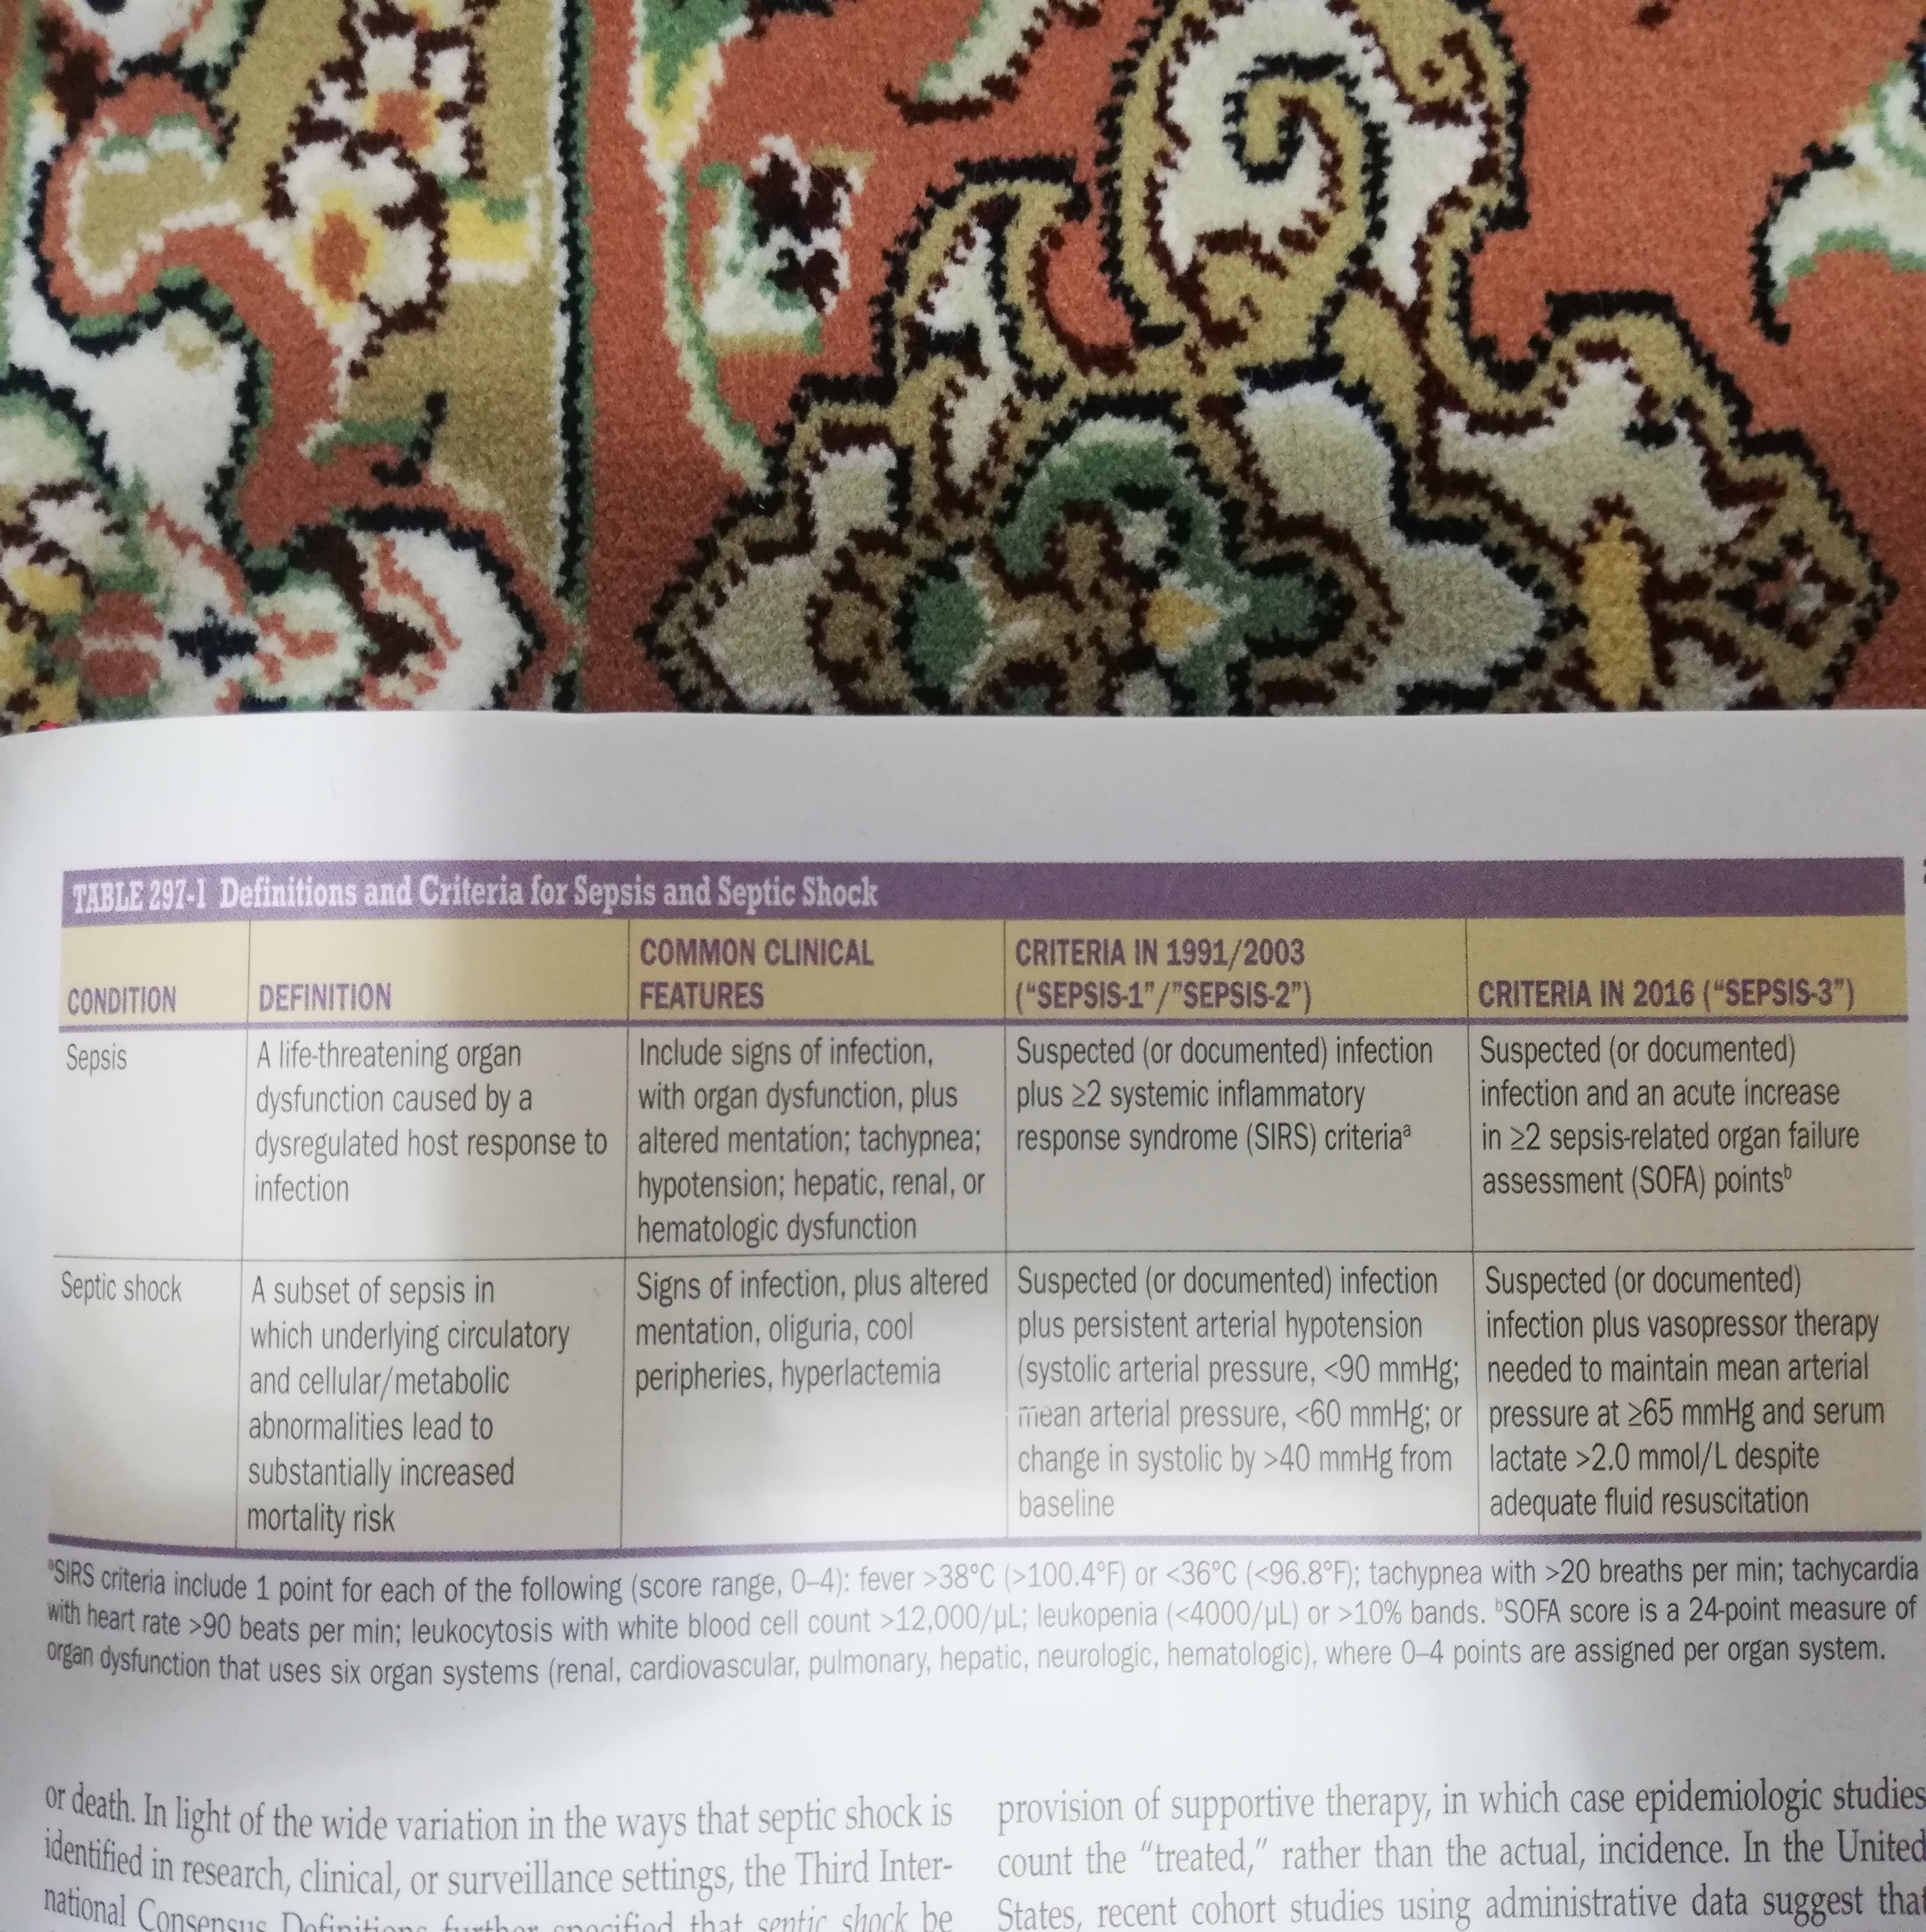

Slide 4
Etiology
Pneumonia
Genitourinary tract
Intraabdominal
Blood culture positive in one-third of cases is positive
Gram positive: staphylococcus aureus , streptococcus pneumonia
Gram negative: E.coli, klebsiella sp., pseudomonas aeruginosa
In ICU : 62% gram negative, 47% gram positive, 19% fungi
Incidence : higher in extreme of age , blacks

Slide 5
Approach to the patient
Suspected or documented infection accompanied by acute, life-threatening organ dysfunction
The clinicianˊs acumen is still crucial to the diagnosis of infection

Slide 6
Clinical manifestation
Cardiorespiratory failure : hypoxemia , bilateral infiltrate of lung, ARDS
Cardiovascular compromise typically presents as hypotension
Kidney injury: AKI in > 50% of patients, increasing mortality 6-8 fold
AKI occure in 25% patients without hypotension
Neurologic complication : coma, delirium, polyneuropathy, myopathy, cognitive impairment

Slide 7
Clinical manifestation
Ileus
elevated aminotransferase
altered glycemic control
DIC
adrenal dysfunction
sick euthyroid syndrome

Slide 8
Diagnosis(laboratory and physiologic finding)
Hypotension : SBP≤100 mmhg
SaO2 ≤ 90%
Hypoalbuminemia , troponin elevation, hypoglycemia, hypofibrogenemia
Quick SOFA : SBP ≤ 100 mmhg , tachypnea ≥22/min , altered mentation
Septic shock : 1)sepsis + 2) the need for vasopressor therapy to elevate mean arterial pressure to ≥ 65 mmhg , with 3) a serum lactate concentration > 2 mmol/L after adequate fluid resuscitation

Slide 9
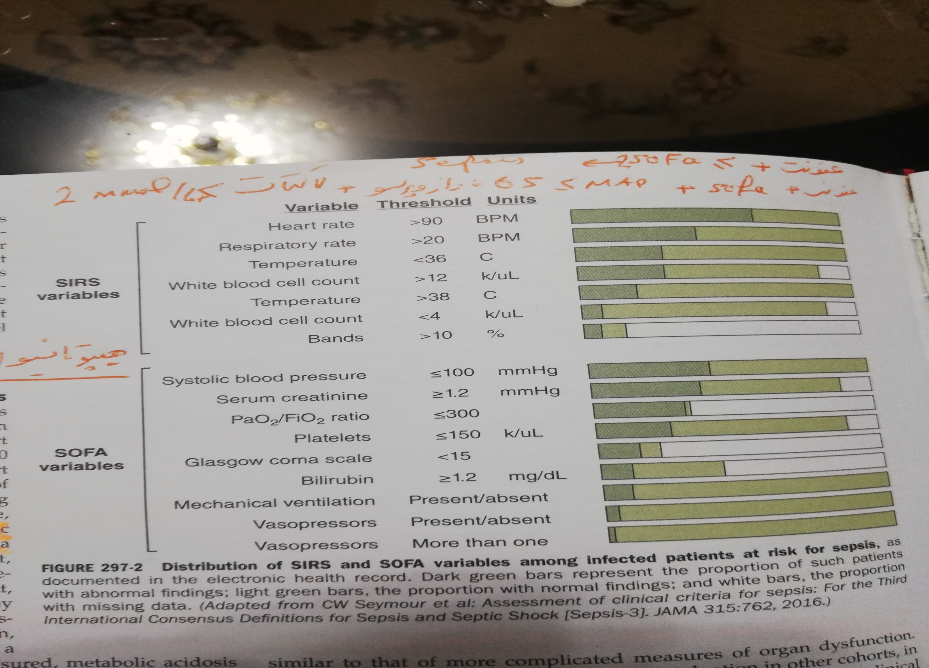

Slide 10
Treatment
IV crystalloid fluid 30 ml/kg within the first 3 h.
Norepinephrine first vasopressor choice
Dopamine only in tachyrrhthmias or relative bradycardia
Dobutamine if hypoperfusion persist after adequate fluid and vasopressor therapy
Blood transfusion if Hb<7 (In the absence MI, sever hypoxemia, or acute hemorrhage)
IV antibiotic within 1 h.
Tidal volume of 6 ml/kg

Slide 11
Treatment
Arterial catheter if vasopressor is needed
Hydrocortisone if hypotension present after adequate fluid and vasopressor therapy
Insulin therapy if BS > 180 mg/dl
Heparin
Stress ulcer prophylaxis
Vasopressin 0.03 U/ml/min adding to norepinephrine to decrease norepinephrine dose
Indication of mechanical ventilation : PaO2<60, SaO2<90, increased work of breathing, metabolic acidosis with PH<7.2
IV immunoglobulin

Slide 12
